Slide 1
Final Presentation
A Multi-Method Approach to Molecular Activity Prediction
28th May, 2025
Group 2: Carlotta Hölzle, Kevin Karim, Kusumastuti Cahyaningrum

Slide 2





Agenda
Project
Results & Discussion
Data Exploration
Conclusion
Methodology
Notes:
Kevin

Slide 3
Project

Slide 4
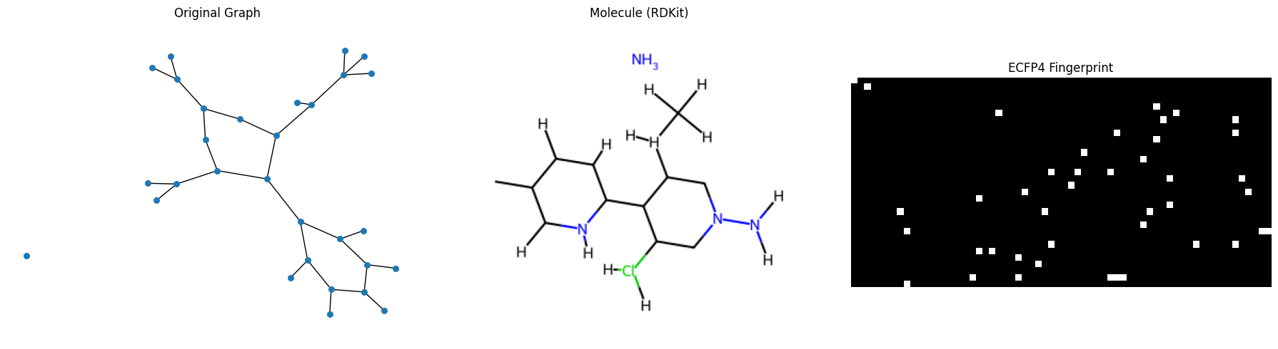
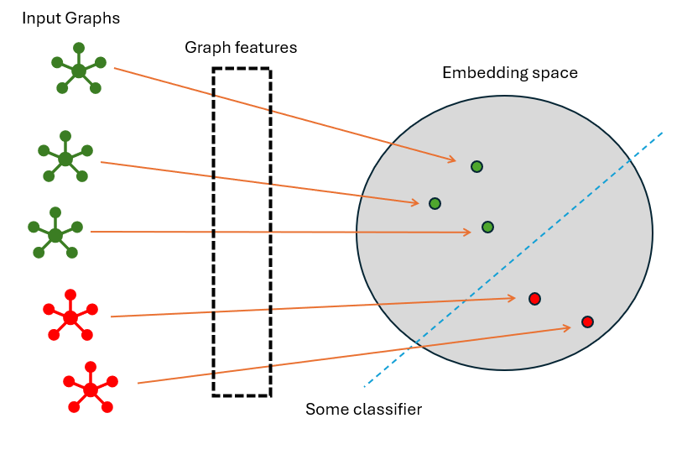
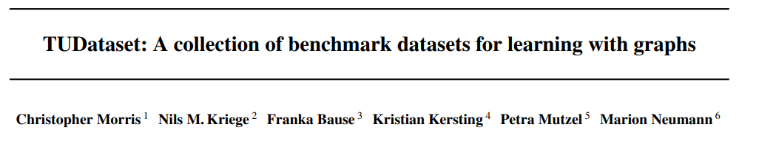
Project Introduction
Graphs of molecular structure
from TUDataset
undirected graphs
No edge weights
Node label for atoms
Graph label (active/inactive)
Binary graph classification
Notes:
Kevin
Biological datasets
Undirects edges
No edge weights
Node labels for atoms
Graph labels
Graph classification
Motivation
We want bioloigal data
Used in previous research
It has downstream value for drug discovery
Easy to work with in python

Slide 5
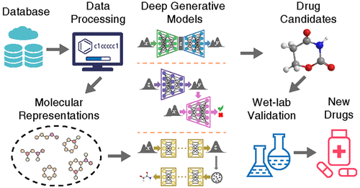
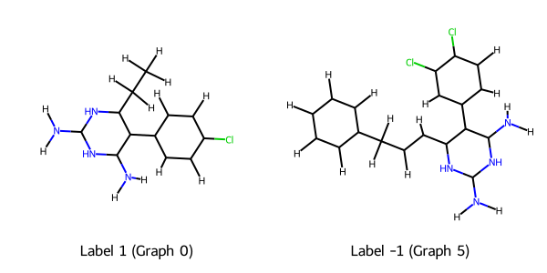

Our Project
TUDatabase
Data Processing
Graph Classification
Possible Drug Candidates
Active
Inactive
Molecular Representation
GNN & ML Methods
Wet Labs
New Drugs
https://pubs.acs.org/doi/10.1021/acs.jcim.3c01496

Slide 6
Research Gap
Evaluating ML vs. GNN model performance across multiple biochemical datasets
Relating statistical relevance of SPID, clustering, density to classification strength
Comparing performance of 3 input paradigm:
(1) Topology
(2) Fingerprints
(3) GNN learned embeddings
Linking model performance to graph structural characteristics
Notes:
1. Despite the wide adoption of ML and GNN approaches, little is known about comparative strength across multiple biochemical datasets

Slide 7
Research Question
“Which type of representation and architecture works best for which dataset, and can we produce general recommendations to avoid exhaustive model and feature testing?”

Slide 8
Project Timeline
Data Exploration
Modelling
Evaluation
Data Preprocessing
Graph theoretical metrices
K-fold Cross Validation
Data Distribution Analysis
ML classifier
Structural Analysis
Runtime comparison
Data Visualization
GNN
Accuracy, ROC-AUC score

Slide 9
Methodology

Slide 10

Metodology
1
2
3
4
5
6
Graph features
Statistical relevance
scipy
Fingerprints
Build for all datasets
RDKit
Train ML models
GT, FP & combined
sklearn
Train GNNs
GCNconc & GraphConv
PyTorch Geometric
Evalutate and compare
Accuracy
ROC AUC
Runtime
Structural differences
Networkx
scipy

Slide 11
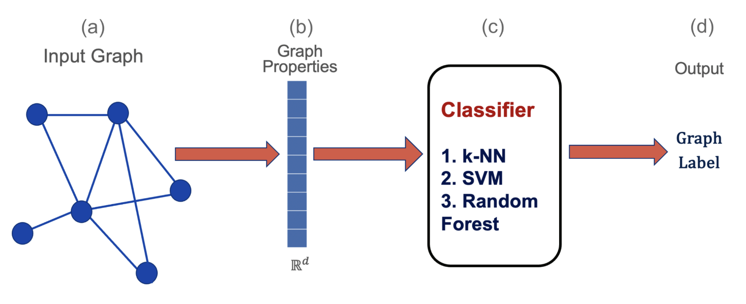
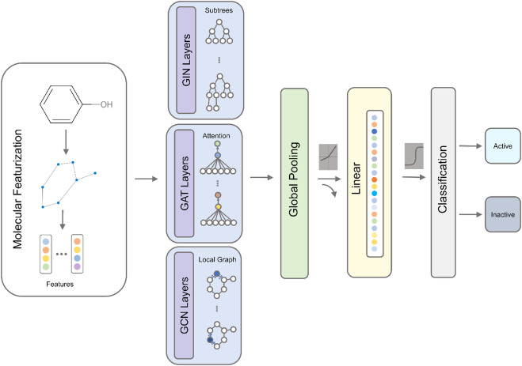
ML Approach
Graph Properties
Density
avg. clustering
SPID
num Edges/ Nodes
std./mean/min/max Degree
Diameter
Radius
Graph Properties
Fingerprints
Fingerprints

Slide 12
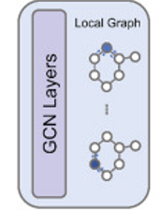
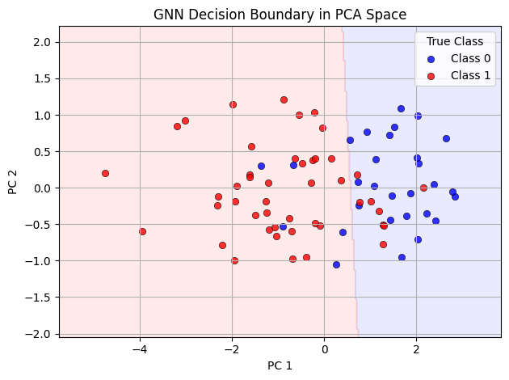
GNN Approach
Classical GCN approach
GCNConv
GraphConv
- No Neighbourhood normalization
- Skip Connection
From GraphConv on a subset of DHFR

Slide 13
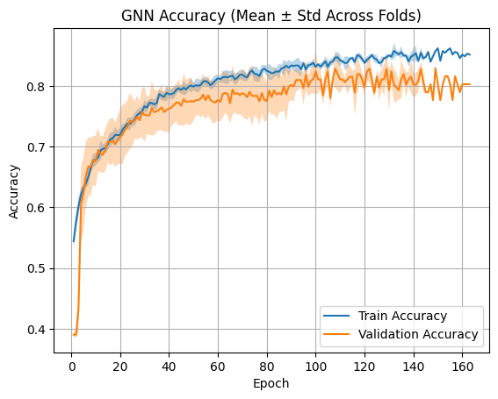
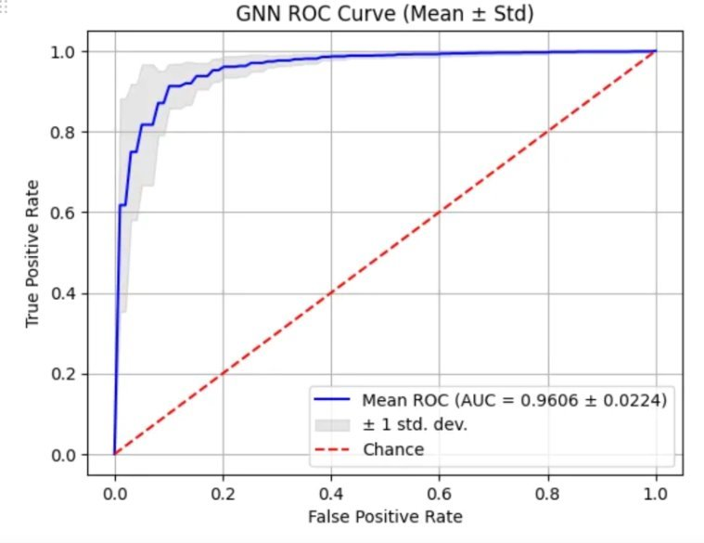
Evaluation Metrics
Accuracy
ROC-AUC
From GraphConv on a DHFR dataset
From GraphConv on a AIDS dataset

Slide 14
Data Exploration

Slide 15
Data Selection
Dataset | Class 0 | Class 1 | Class 0 | Class 1
AIDS | 20% | 80% | 400 | 1,600
DHFR (Class -1, 1) | 39.02% | 60.98% | 295 | 461
PTC_MR (Class -1, 1) | 55.81% | 44.19% | 192 | 152
Mutagenicity | 55.36% | 44.64% | 2,401 | 1,936
NCI1 | 49.95% | 50.05% | 2,053 | 2,057
PTC_FM (Class -1, 1) | 59.03% | 40.97% | 206 | 143
Tox21_MMP_training | 84.40% | 15.60% | 6,178 | 1,142
Tox21_ER_training | 87.83% | 12.17% | 6760 | 937
Yeast | 87.98% | 12.02% | 70,033 | 9,568
OVCAR-8H | 94.87% | 5.13% | 38,437 | 2,079
MCF-7H | 91.74% | 8.26% | 25,476 | 2,294
Tox21_HSE_training | 94.75% | 5.25% | 7,722 | 428
Tox21_aromatase_training | 95.02% | 4.98% | 6,866 | 360
Tox21_PPAR-gamma_training | 97.29% | 2.71% | 7,962 | 222
MOLT-4 | 92.10% | 7.90% | 36,625 | 314
NCI-H23 | 94.90% | 5.10% | 38,296 | 2,057
UACC257 | 95.89% | 4.11% | 38,345 | 1,643
DHFR: good class balance, medium sized
AIDS: high class imbalance
PTC: small dataset
Mutagenicity: large dataset
Notes:
KC
Looking at the data intrinsic features we can see that in the TU dataset most of the datasets have a high class imbalance
Thus first we looked for a dataset which had medium size and low class imbalance. This dataset we used to “get started”
In a second step (once all our pipelines existed) we looked for additional datasets which could give information on how our models perform with a not-so-smooth dataset at hand
Thus we looked for one dataset with high class imbalance to test how the models performances change in such a setting and which model performs best given high class imbalance
Then we looked for two datasets extreme in size, e.g. very large and very small (large still in a magnitude such that our local hardware can handle it)
Following these criterias we settled on AIDS, DHFR, PTC, Mutagenicity respectively

Slide 16
Datasets
4 datasets with active/inactive classifications
1
DHFR
Target key enzyme in chemotherapy
2
AIDS
Ability to inhibit HIV replication
3
Mutagenicity
A chemical compound dataset of drugs, which can be categorized into two classes: mutagen and non-mutagen.
4
PTC (Predictive Toxicology Challenge)
A collection of chemical compounds which report the carcinogenicity for rats.
Notes:
KC
We picked 4 different datasets – each having a very important implication for downstream drug research 1. DHFR is important for rapidly dividing cells, like cancer cells or bacteria, making it a common target for drugs, especially in cancer treatment and antibiotics.
So, drugs that inhibit DHFR can slow down or stop the growth of harmful cells.
3. Labeled based on whether it can cause genetic mutations (mutagen) or not (non-mutagen).
4. it tells us whether each one causes cancer in rats, with extra details about different parts of each compound.
The DHFR dataset contains small organic molecules (drug-like compounds). They are synthetic or experimental compounds — small chemical molecules that scientists have designed, collected, or studied in laboratories.
These molecules are potential inhibitors of an enzyme called DHFR (Dihydrofolate Reductase).
Structurally, they are diverse: many contain aromatic rings, amine groups, and heterocycles — common motifs in drug discovery
DHFR is a critical enzyme in cells: it helps convert dihydrofolate to tetrahydrofolate.
Tetrahydrofolate is necessary for the synthesis of DNA, RNA, and proteins.
Thus, DHFR is essential for cell replication and survival.
This changed to last time:
-> now 4 vs. last time only one

Slide 17
Related Work (Accuracy)
Dataset | ML | GNN
AIDS | ^{[6]} kNN 97.3 % | ^{[1]}FIT-GNN: 84.3
DHFR | ^{[7]} SVM 80.8% | ^{[2]}GIN 80.04
PTC_MR | ^{[8]} SVM 68.61 % | ^{[3]}GCN 64.20
Mutagenicity | ^{[9]}SVM 84 % | ^{[4]}GCN 79.81%
[1] Roy et al., (2024). FIT-GNN: Faster Inference Time for GNNs Using Coarsening. arXiv:2410.15001
[2] Hevapathige & Wang (2025). Permutation-Invariant Graph Partitioning: How Graph Neural Networks Capture Structural Interactions? arXiv:2312.08671
[3] Nguyen et al. (2022). Universal Graph Transformer Self-Attention Networks. arXiv:1909.11855
[4] Zhang et al. (2019). Hierarchical Graph Pooling with Structure Learning. arXiv:1911.05954
[5] Bechler-Speicher et al. (2022). Graph Trees with Attention. arXiv:2206.01234
[6] Riesen, Kaspar, and Horst Bunke. "IAM graph database repository for graph based pattern recognition and machine learning." Structural, Syntactic, and Statistical Pattern Recognition: Joint IAPR International Workshop, SSPR & SPR 2008, Orlando, USA, December 4-6, 2008. Proceedings. Springer Berlin Heidelberg, 2008.
^{[7]} Kriege, Nils, and Petra Mutzel. "Subgraph matching kernels for attributed graphs." arXiv preprint arXiv:1206.6483 (2012).
^{[8]} Islam, Saiful, Md Nahid Hasan, and Pitambar Khanra. "A Structural Feature-Based Approach for Comprehensive Graph Classification." arXiv preprint arXiv:2408.05474 (2024).
^{[9]} Helma, Christoph, et al. "A comparison of nine machine learning mutagenicity models and their application for predicting pyrrolizidine alkaloids." Frontiers in pharmacology12 (2021): 708050.
Notes:
KC
Todo: reference this in the report -> e.g. baseline reference
-> we are using pretty standard GNN and want to see how close we come to the state-of-the-art
Todo: include related work on ML model
-> I would not have the screenshots like this but actual numbers e.g. what is their accuracy on the datasets such that we can compare later on
Mutagenicity: 71.5% , 87.4 (https://icml.cc/2012/papers/542.pdf; geometric random walk), random forest: 93.10, SVM: 89.66
AIDS: 97.3%
DHFR: 89/87 (active vs. inactive respectively) -> 88% ; 80.8 (https://icml.cc/2012/papers/542.pdf, SVM with pharmacophore kernel )
PTC_MR: 59.3 (Shortest Path) https://www.sciencedirect.com/science/article/pii/S016786552400254X, SVM: 68.61

Slide 18
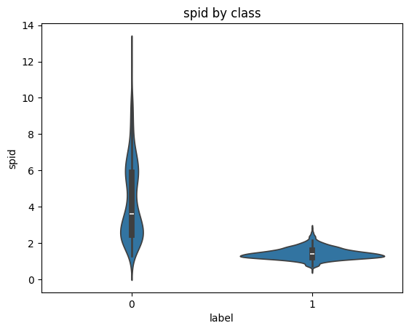
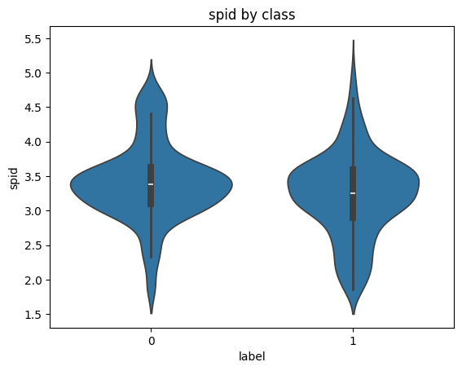
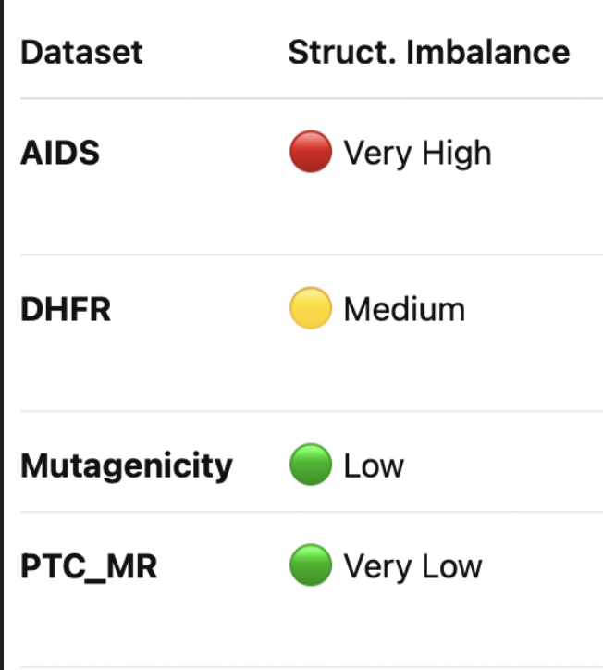
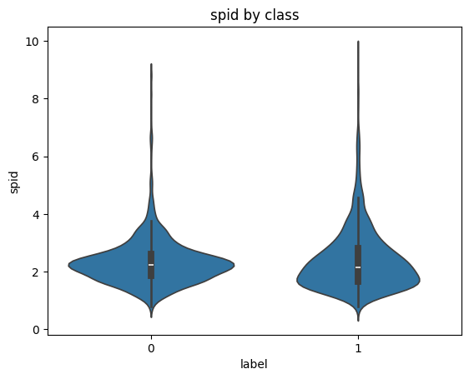
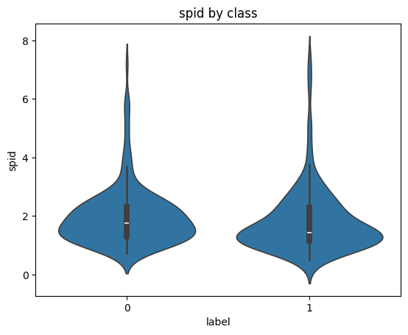
SPID
AIDS
DHFR
Mutagenicity
PTC_MR
Notes:
Num nodes, num edges, density, SPID, clustering coefficient, avg. degree

Slide 19
Evaluation ML models

Slide 20
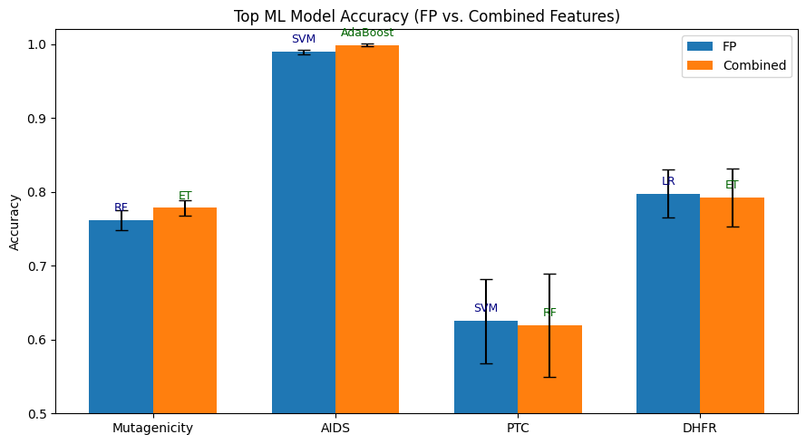
Top Performing ML Models
Should we incluse bar for only graph theoretic here also?
SVM and RF on average best performing model
Adding GT features does not on average increase performance
Top performing models do not stay the same
Notes:
Mutagenicity: FP: Training Time: 11.44 seconds
Combined: ExtraTree: Training Time: 16.57 seconds AIDS FP: SVM: 22.231395
AIDS Combined: AdaBoost: 8.219920
PTC FP: SVM: 1.81
PTC Combined: RF: 1.14
DHFR FP LR: Training Time: 0.84 seconds
DHFR Combined ET: Training Time: 1.65 seconds

Slide 21
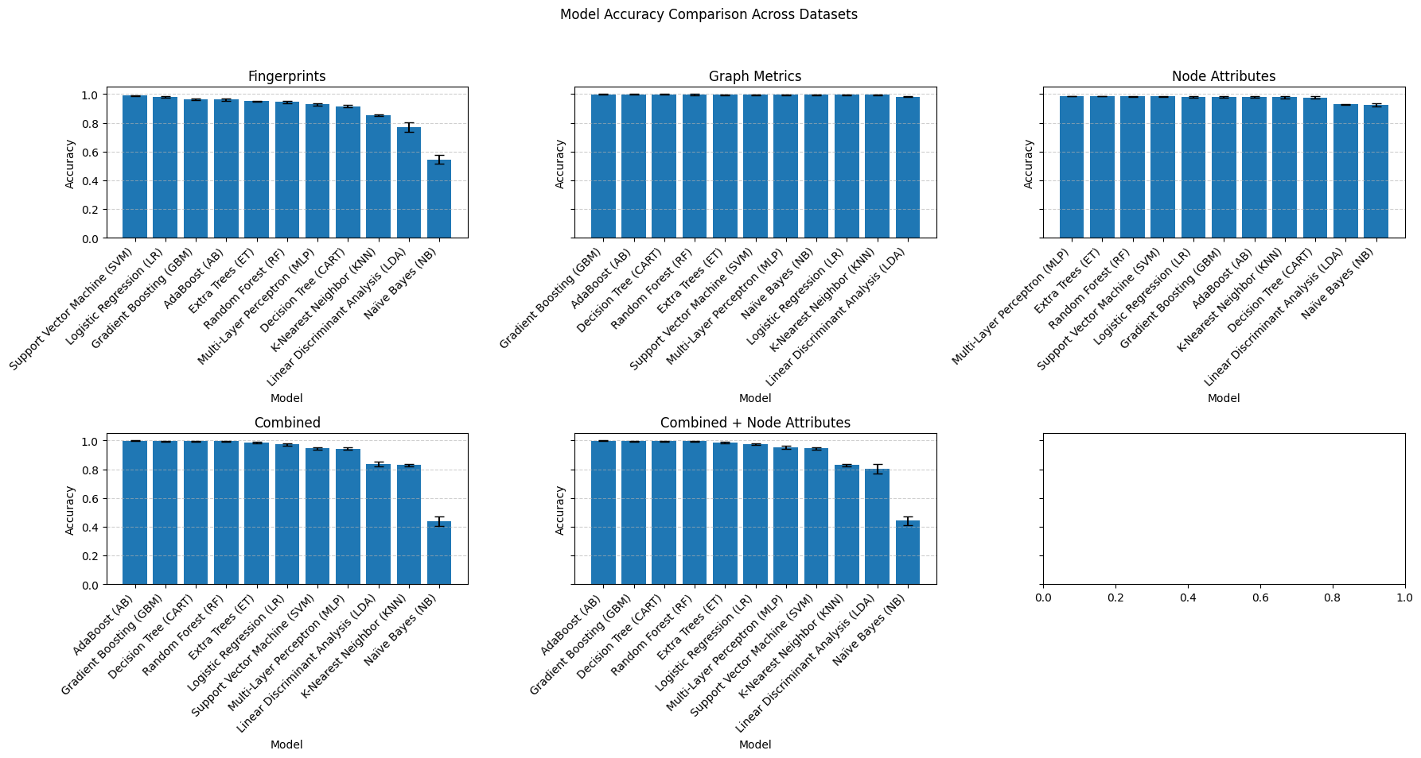
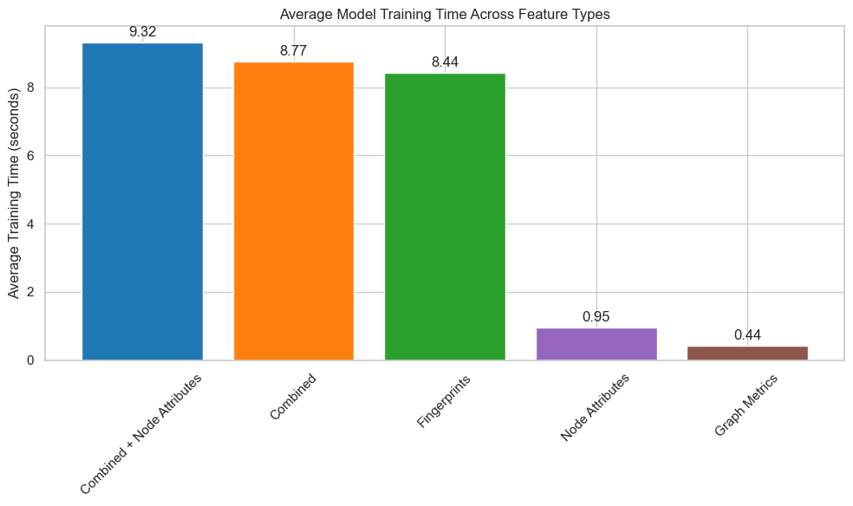
Accuracy Comparison AIDS
Training on node attributes is faster and gives same performance as fingerprints

Slide 22
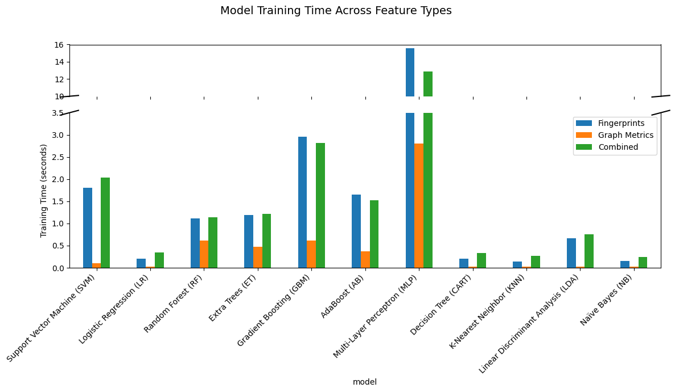
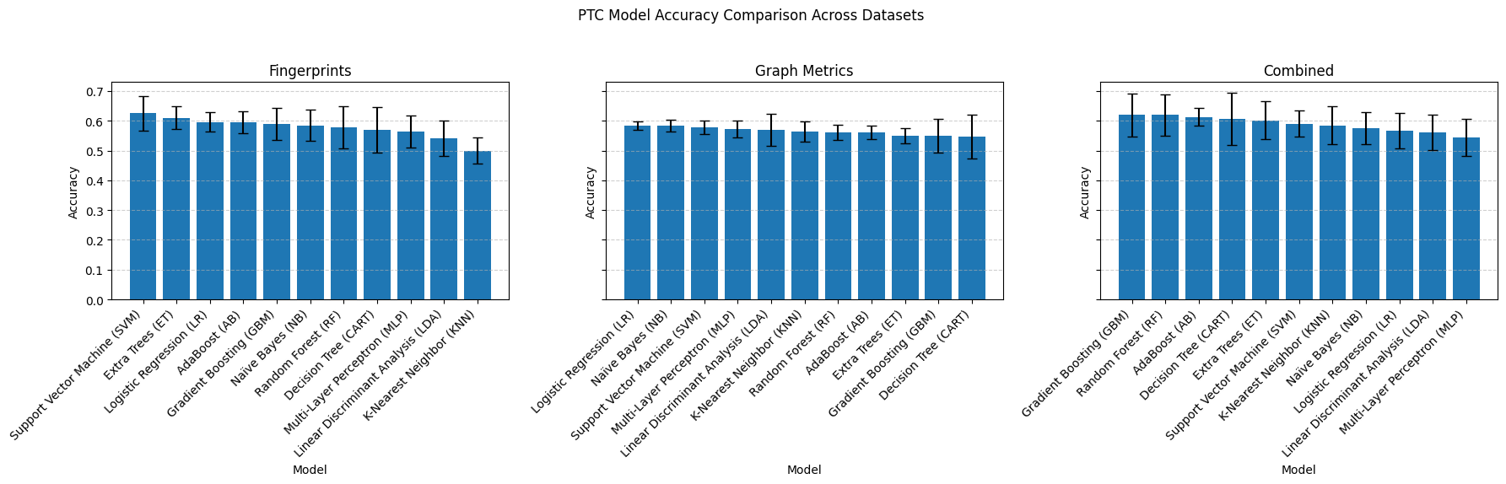
Accuracy Comparison PTC_MR
Longer training does not always translate in better performance
Smaller differences across models, on average lower std. deviation
Some models benefit more than others from the combination of features

Slide 23
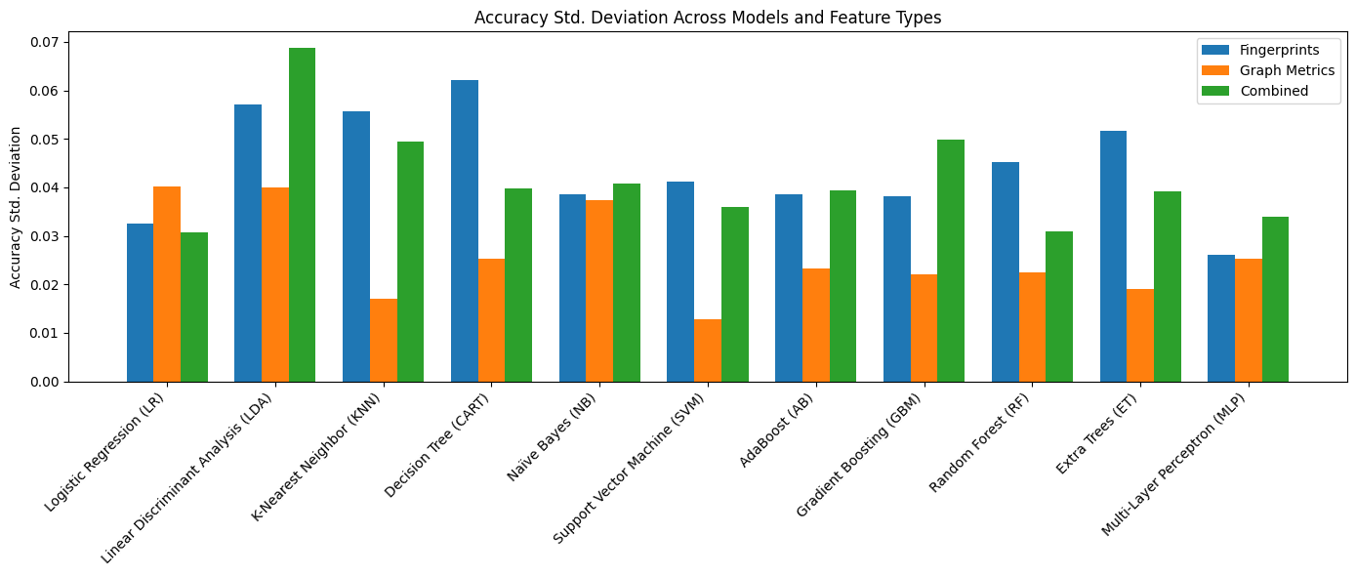
Accuracy std. dev. Comparison
GT lower std. deviation
On average std. deviation decreases when adding both characteristics together, but not always

Slide 24
Evaluation GNN models

Slide 25
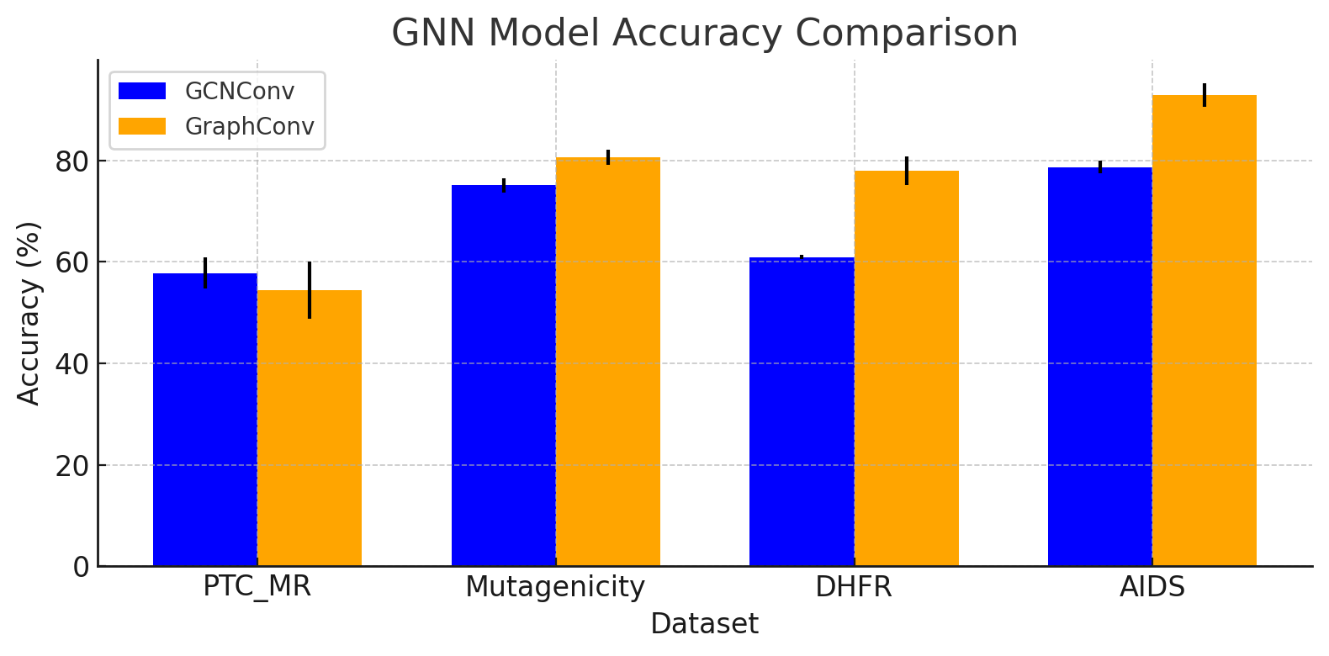
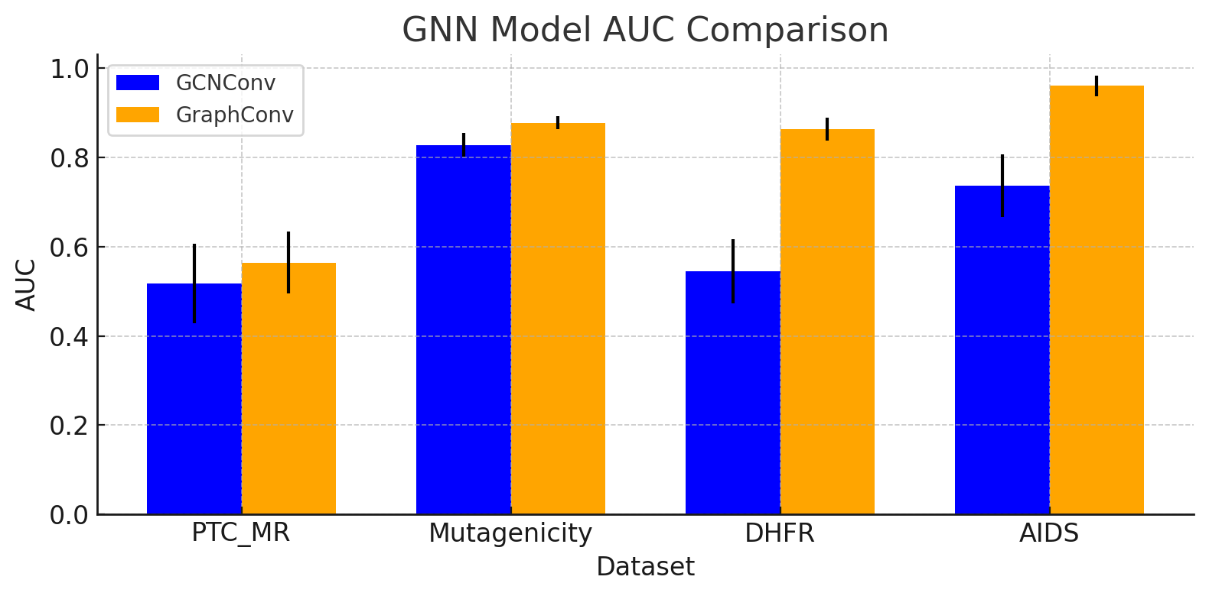
GNNs Performance Comparison
ΔACC=-3.4%
ΔACC=5.5%
ΔACC=17.1%
ΔACC=14.2%
ΔAUC=4.8%
ΔAUC=4.9%
ΔAUC=31.9%
ΔAUC=22.3%
Increase in structural differences between classes
GraphConv consistently outperforms GCNConv in
ROC-AUC
GraphConv display better performance under class imbalance
With lower structural difference models get closer in performance
Notes:
Accuracy tells how many predictions were right. AUC tells how well the model separates the two classes, especially when dealing with class imbalance (like AIDS and DHFR). Optional Insights on DHFR (3D Structure): GraphConv outperforms GCNConv on DHFR because its spatial aggregation better captures local geometric patterns in 3D molecular structures, whereas GCNConv's spectral normalization tends to over-smooth these critical differences.
Insights:
GraphConv consistently outperforms GCNConv in AUC (especially under class imbalance or structural difference)
GraphConv outperforms GCNConv on DHFR by preserving local 3D patterns that GCNConv's spectral normalization tends to over-smooth. (ΔAUC=31.9% )

Slide 26
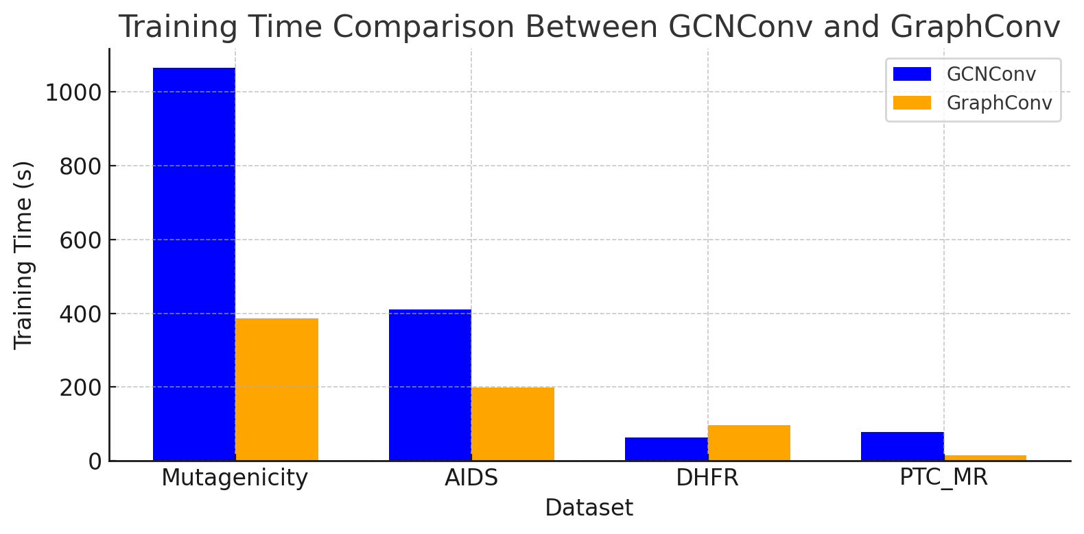
Computational Time GNN Models
Mutagenicity largest dataset -> longest compute
GCNConv longer training times than GraphConv
Dataset size

Slide 27
Top model Comparison

Slide 28
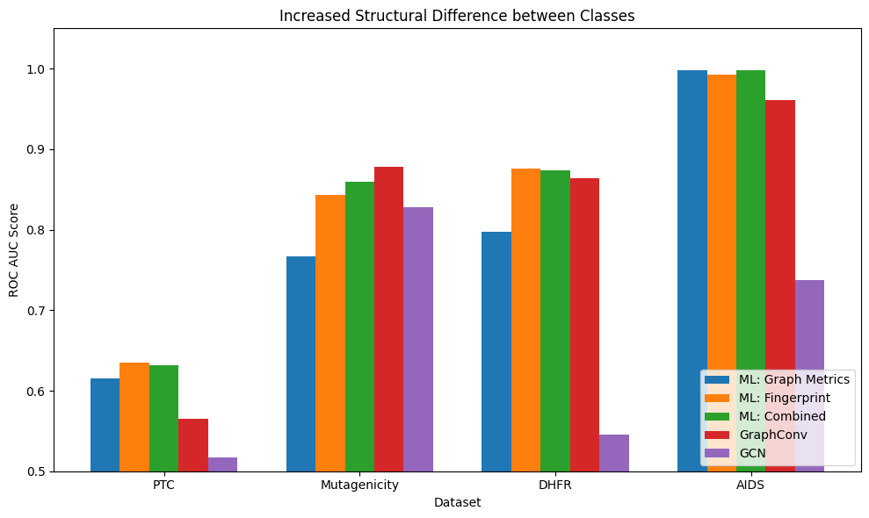
Model Performance Explanation
Large dataset
Medium dataset
Medium dataset
Small dataset
Notes:
Dataset Size Impact:
Performance (ROC AUC) generally increases with dataset size, as seen by comparing the small (PTC), medium (DHFR, AIDS), and large (Mutagenicity) datasets.
Structural Difference Matters:
Increased structural differences between classes correlate positively with higher model performance. Datasets placed further right on the axis (indicating higher structural difference) consistently show better ROC AUC scores.
Fingerprint Features Excel:
Machine learning models trained with fingerprint features (orange) outperform models based solely on graph metrics (blue), indicating that fingerprints capture chemical properties more effectively.
Graph Neural Networks (GCNs) Struggle:
GCN models (purple) underperform across all datasets compared to traditional ML methods (Fingerprint, Combined). This highlights limitations in GCN generalization or the effectiveness of graph embeddings on these biochemical datasets.

Slide 29
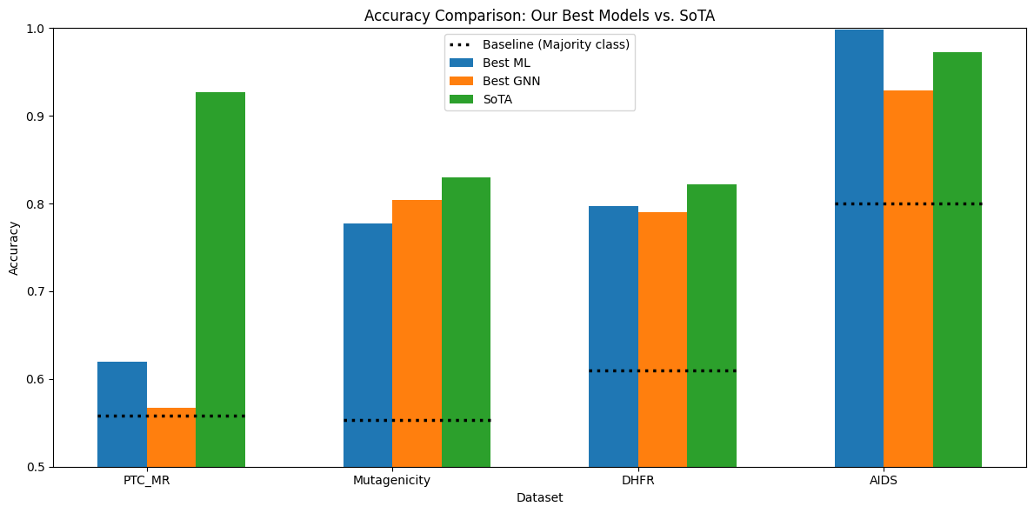
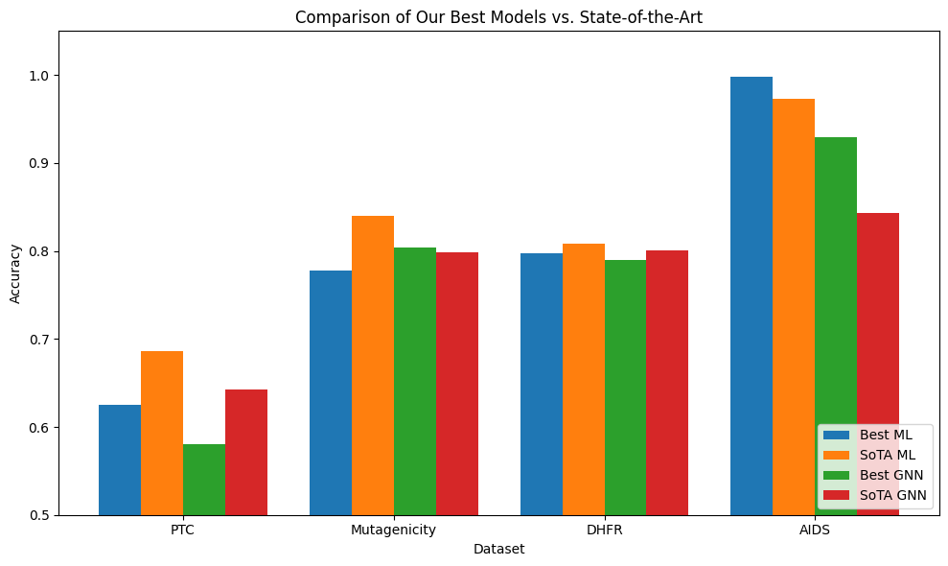
Best Performing Models vs. SOTA
Notes:
Mutagenicity: 71.5% , 87.4 (https://icml.cc/2012/papers/542.pdf; geometric random walk), random forest: 93.10, SVM: 89.66
AIDS: 97.3%
DHFR: 89/87 (active vs. inactive respectively) -> 88% ; 80.8 (https://icml.cc/2012/papers/542.pdf, SVM with pharmacophore kernel )
PTC_MR: 59.3 (Shortest Path) https://www.sciencedirect.com/science/article/pii/S016786552400254X, SVM: 68.61

Slide 30
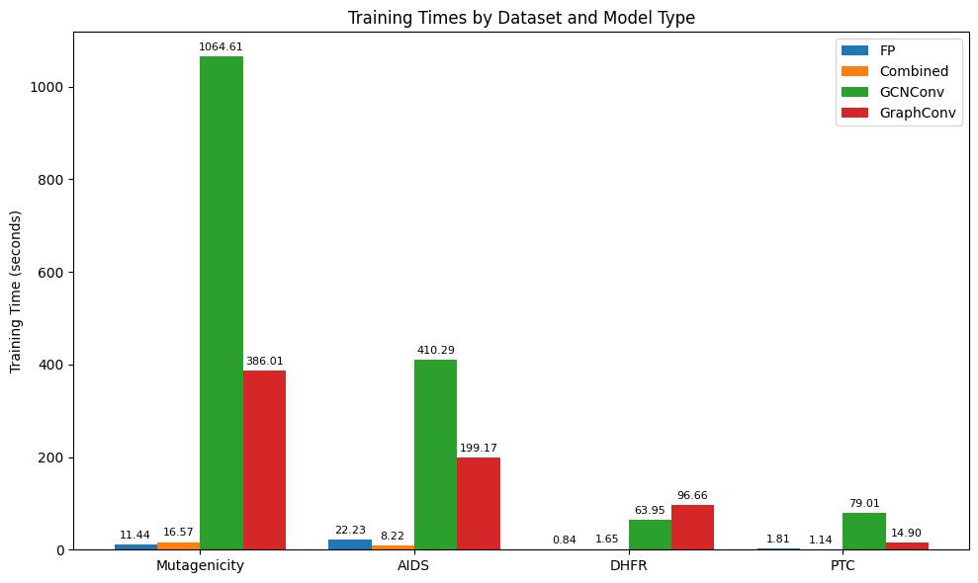

Time Comparison
GNNs ran on Google Colab CPU and ML methods on local CPU

Slide 31
Conclusion

Slide 32
Recommendations
Generally:
Deprioritize structural graph analyses as criterion for selecting models
Use ML models over GNNs for general analysis
Use GNNs only if ML performance is low
Use GPU
Spend efforts on finetuning
For ML models:
Use node-level attributes if available
Use fingerprints as features
Combine fingerprints + graph metrics only if observing high variance
Start with SVM, Logistic Regression, Random Forest
Notes:
On average std. deviation decreases when adding both characteristics together, but not always

Slide 33
Limitations
Future Work
1
Limited scope & computational constraints with GNN architectures
Run SOTA models and compare to ML performance
2
Limited dataset variety in terms of class imbalance
Explore highly imbalance datasets & Graph-resampling techniques
3
Investigate learned fusion models or autoencoder-based hybrid embeddings
Simplistic feature combination
4
Exclusion of chemically invalid molecules
Analyze impact of including edge-case molecules on generalizability
Notes:
Simplistic feature combination: No dimensionality reduction or feature selection

Slide 34
Thank you for listening
Questions?

Slide 35
Backup Slides

Slide 36
GNN Previous Works Comparison (Accuracy)
Dataset | GCNConv | GraphConv | Benchmark | State-of-the-art
AIDS | 78.70 ± 1.27 | 92.90 ± 2.28 | ⁻ | ^{[1]}FIT-GNN: 84.3
DHFR | 60.98 ± 0.4% | 78.04 ± 2.84 | ^{[2]}GIN 80.04 ±4.9 | _{[2] λcore-degree}-GPNN: 82.15 ±2.9
PTC_MR | 57.83 ± 3.12 | 54.40 ± 5.60 | ^{[3]}GCN 64.20 ± 4.3 | ^{[3]}U2GNN_{(Unsupervised)} : 92.67 ± 4.60
Mutagenicity | 75.12 ± 1.38 | 80.61 ± 1.45 | ^{[4]}GCN 79.81 ± 1.58 ^{[4]}GraphSAGE 78.75 ± 1.18 ^{[4]}GAT 78.89 ± 2.05 | ^{[4]}HGP-SL_{GCN}: 82.15±0.58 ^{[5]}TREE-G: 83 (TREE-G: Decision Trees Contesting Graph Neural Networks)
[1] Roy et al., (2024). FIT-GNN: Faster Inference Time for GNNs Using Coarsening. arXiv:2410.15001
[2] Hevapathige & Wang (2025). Permutation-Invariant Graph Partitioning: How Graph Neural Networks Capture Structural Interactions? arXiv:2312.08671
[3] Nguyen et al. (2022). Universal Graph Transformer Self-Attention Networks. arXiv:1909.11855
[4] Zhang et al. (2019). Hierarchical Graph Pooling with Structure Learning. arXiv:1911.05954
[5] Bechler-Speicher et al. (2022). Graph Trees with Attention. arXiv:2206.01234
Notes:
KC
Todo: reference this in the report -> e.g. baseline reference
-> we are using pretty standard GNN and want to see how close we come to the state-of-the-art
Todo: include related work on ML model
-> I would not have the screenshots like this but actual numbers e.g. what is their accuracy on the datasets such that we can compare later on

Slide 37
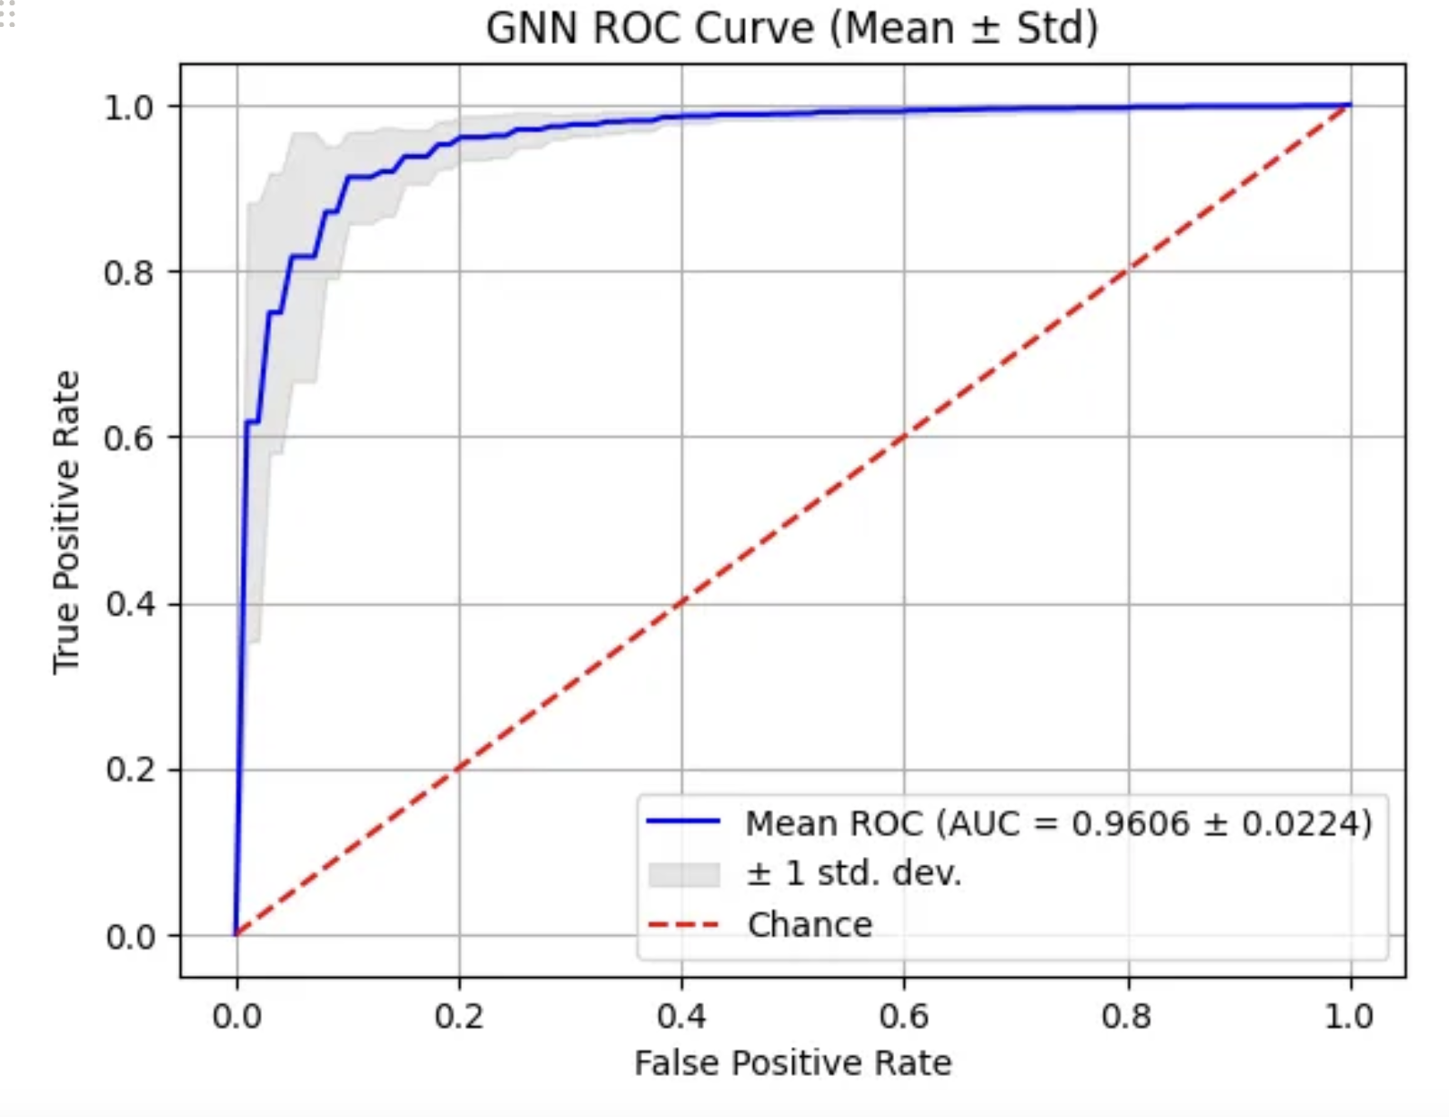
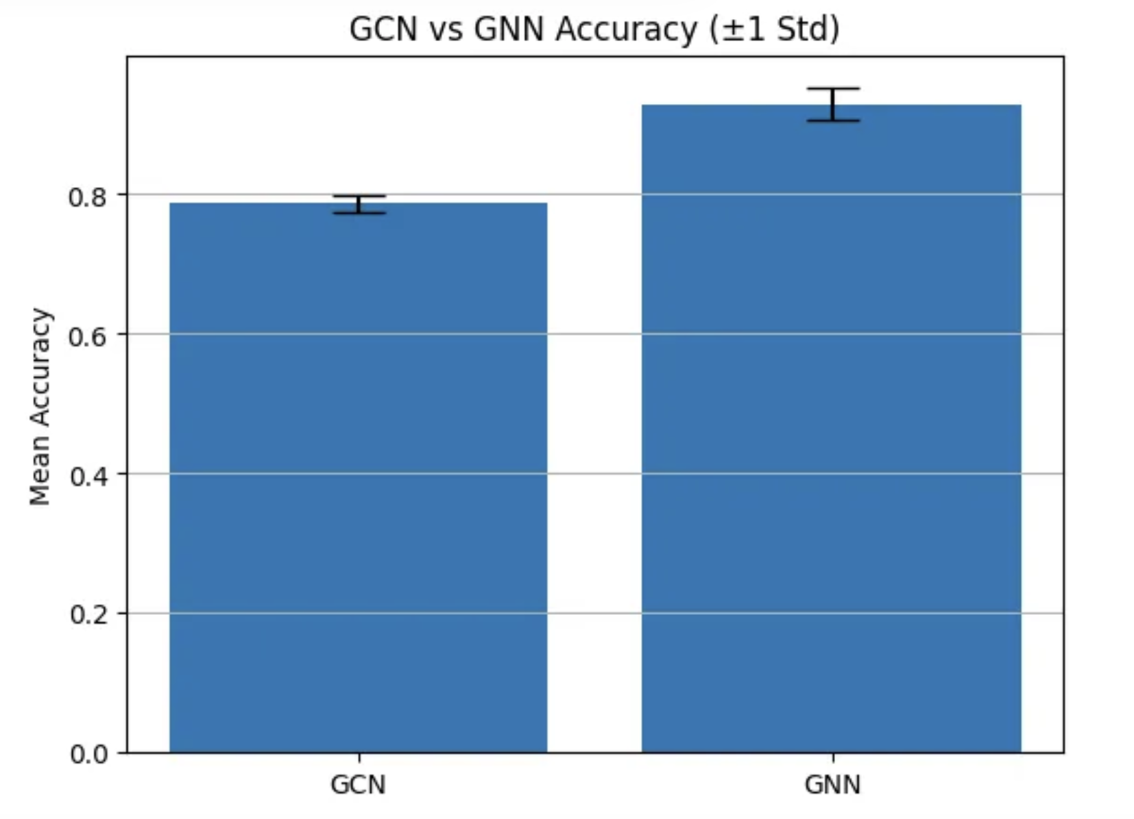
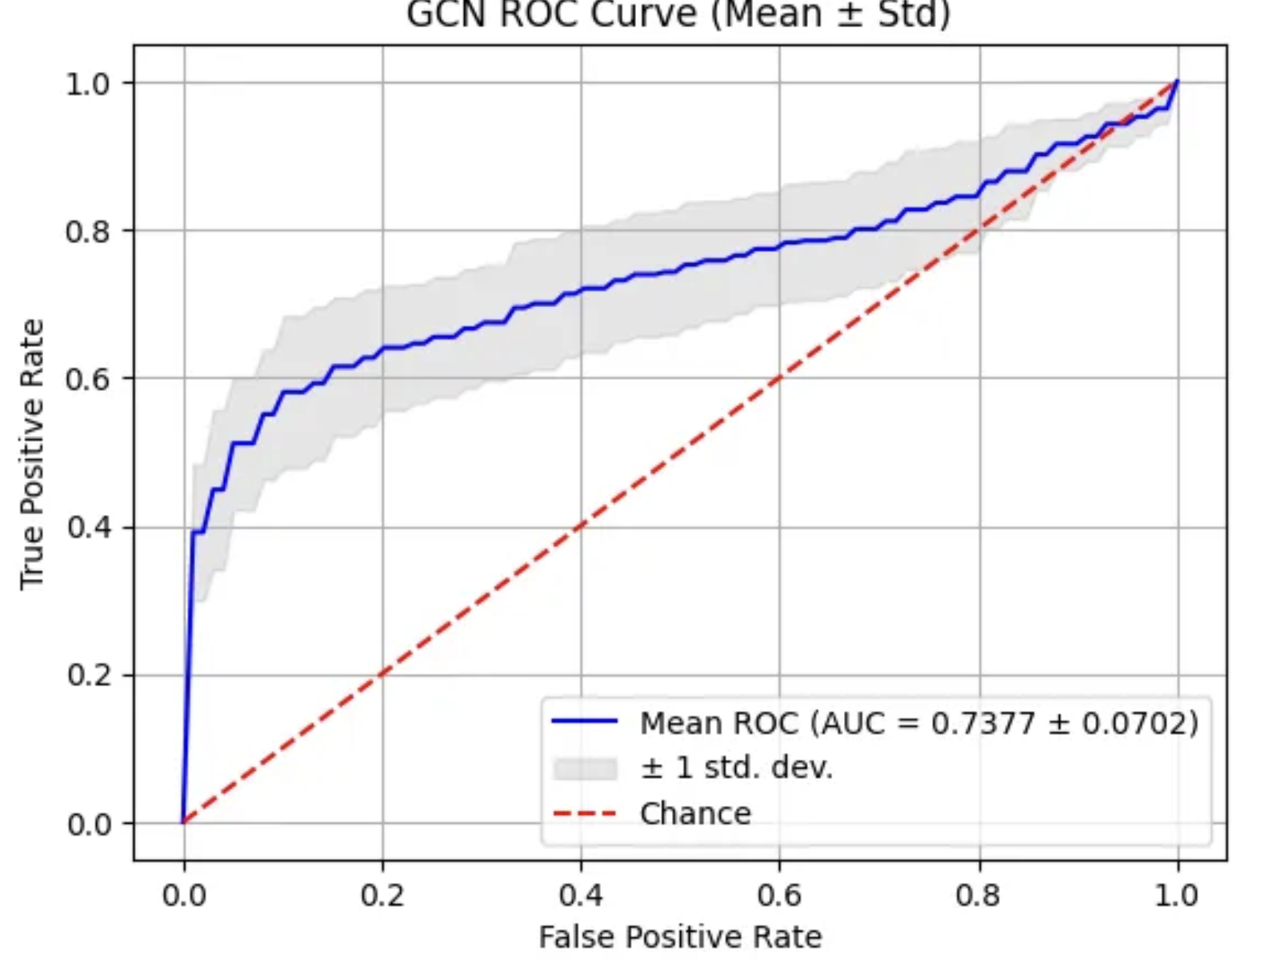
GNN comparison AIDS
GCN Accuracy: 0.7870
GNN Accuracy: 0.9290

Slide 38
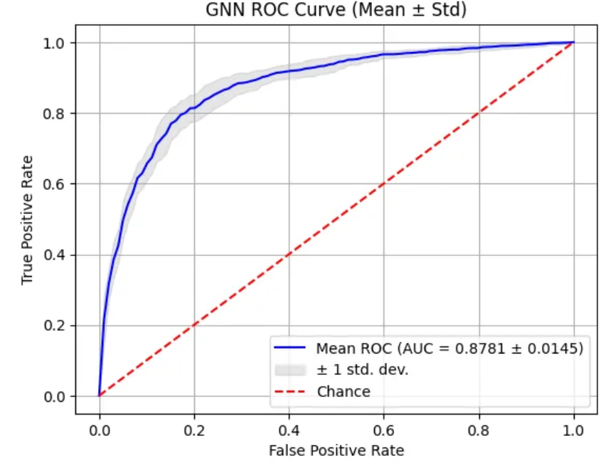
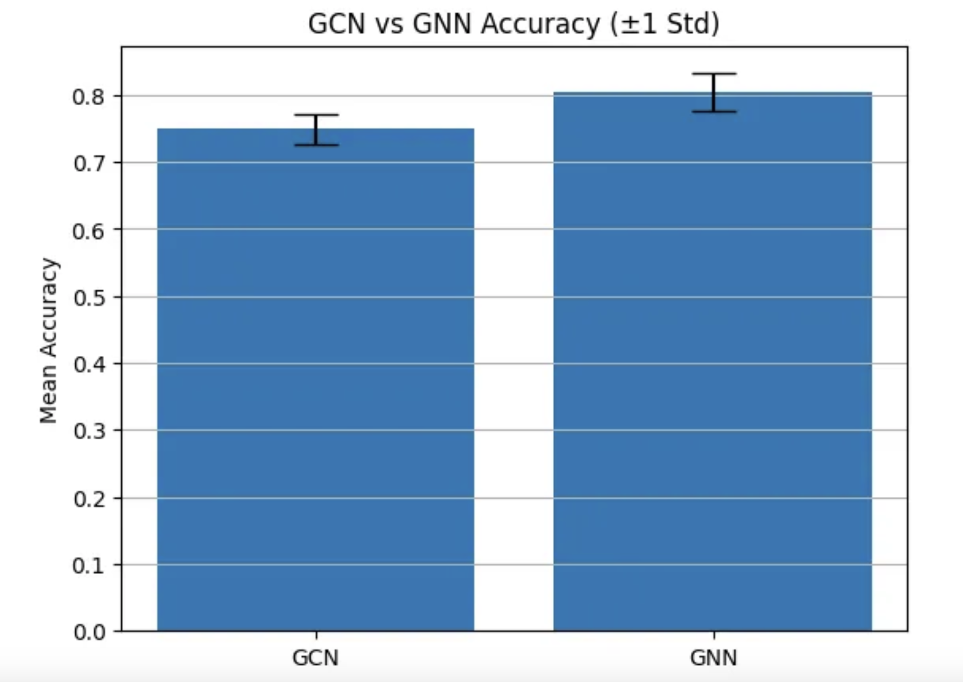
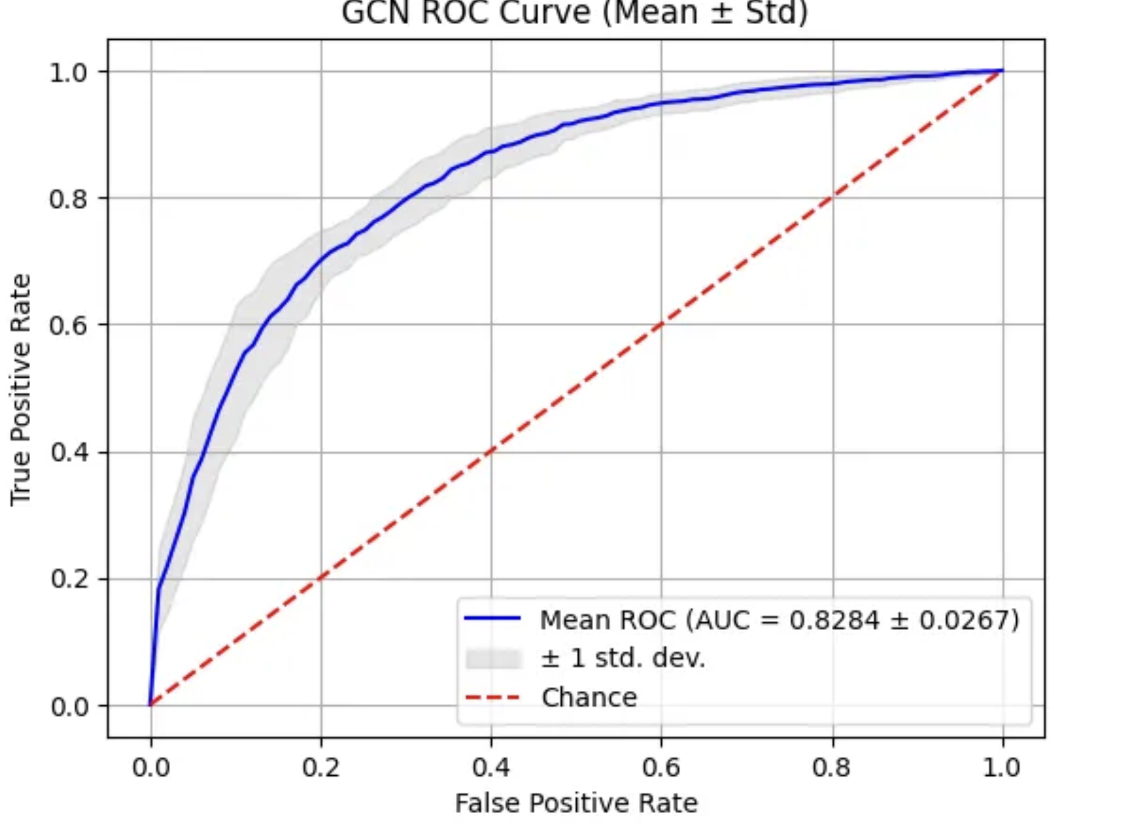
GNN Comparison Mutagenicity
GCN Accuracy: 0.749
GNN Accuracy: 0.8036

Slide 39
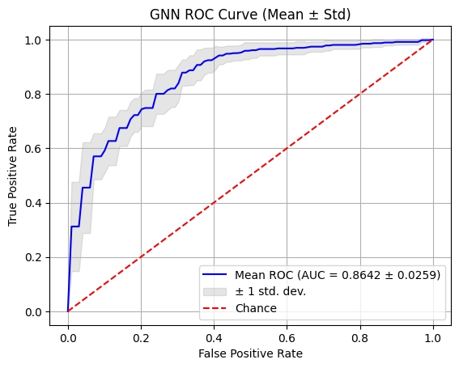
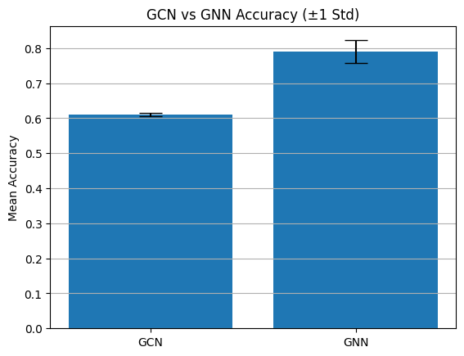
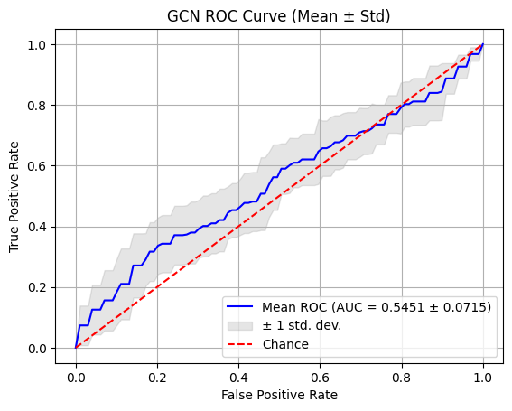
GNNs Comparison: DHFR
GCN Accuracy: 0.6098
GNN Accuracy: 0.7896
Notes:
ChatGPT
What do we see here?
-> why is the GCN so bad here? Hypothesis

Slide 40
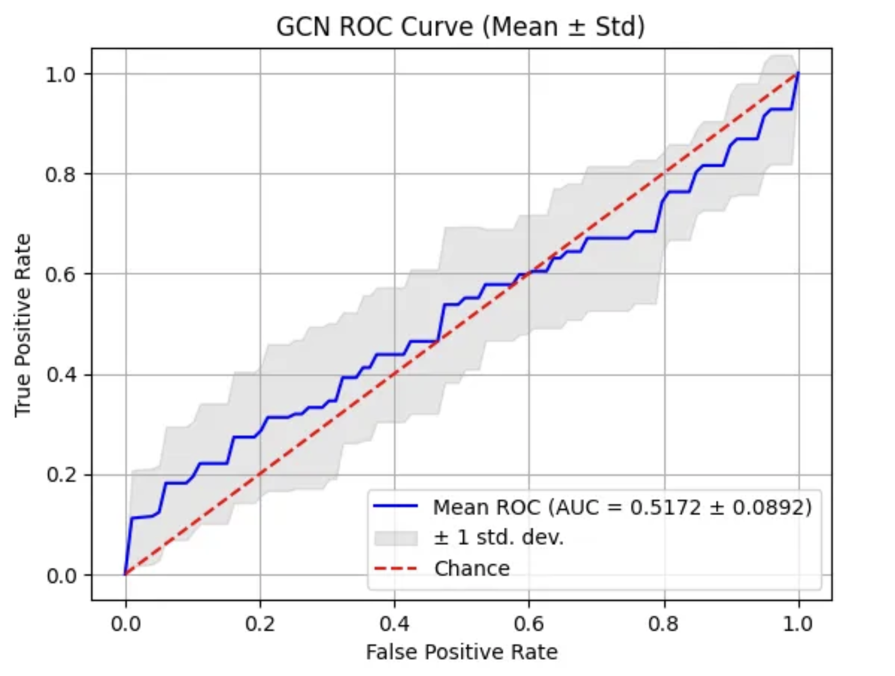
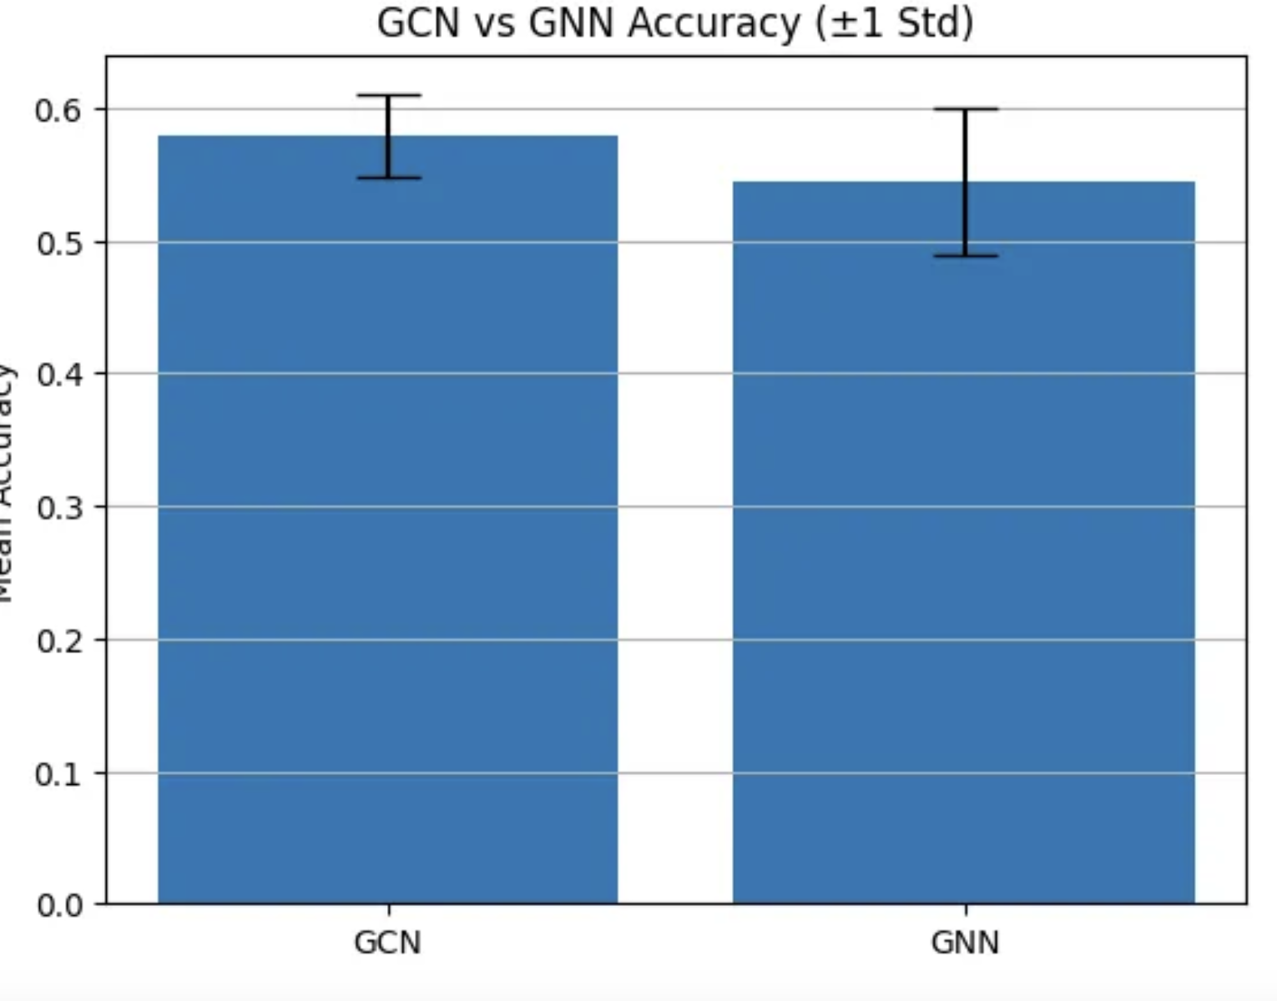
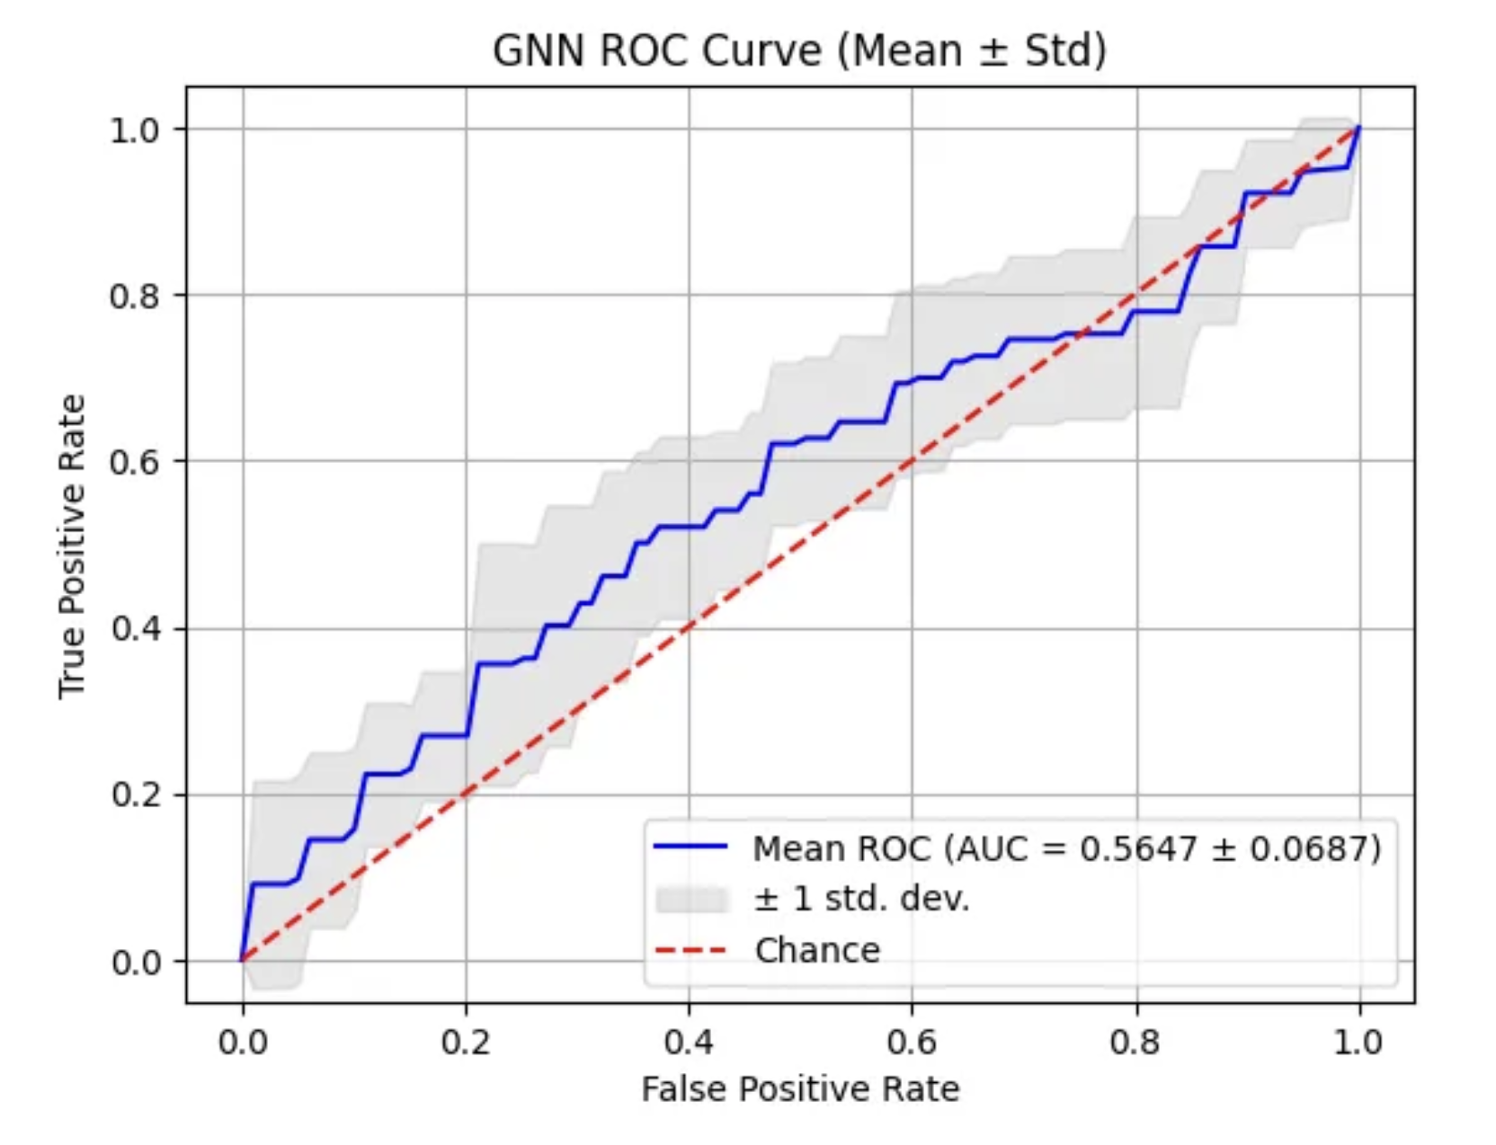
GNN Comparison PTC_MR
GCN Accuracy: 0.5783 ± 0.0312
GNN Accuracy: 0.5440 ± 0.0560

Slide 41
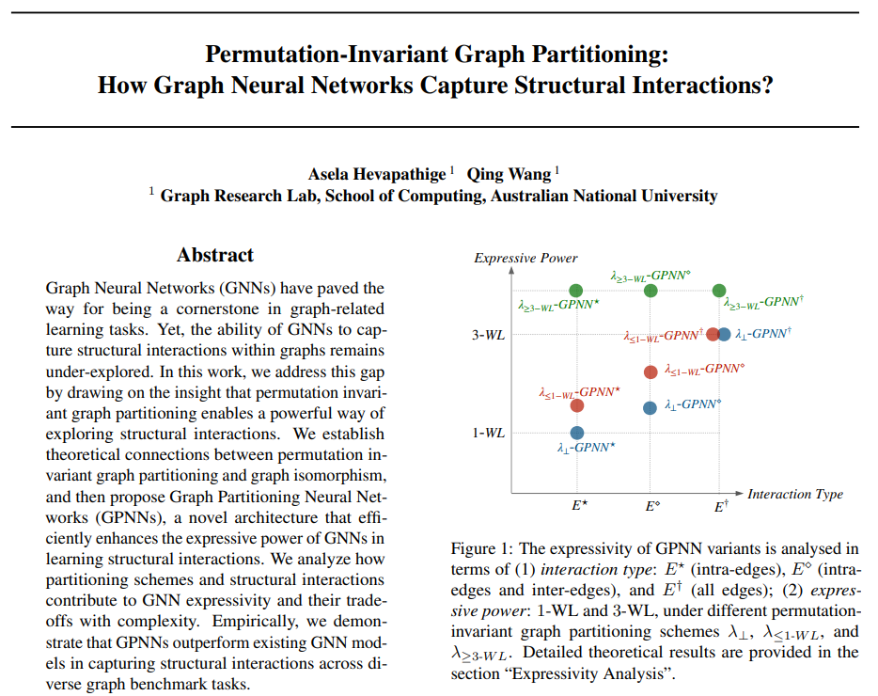
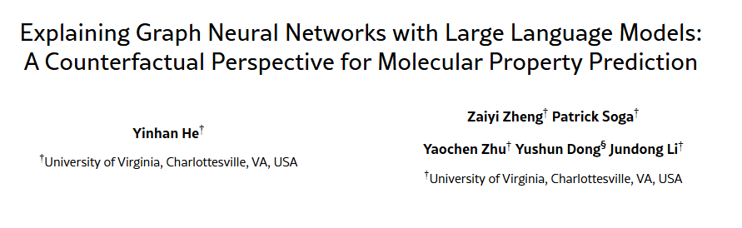
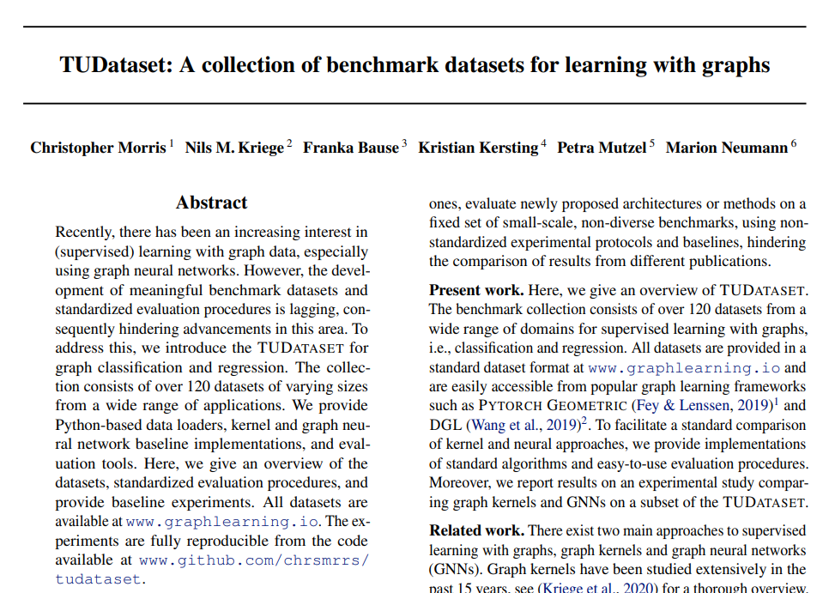
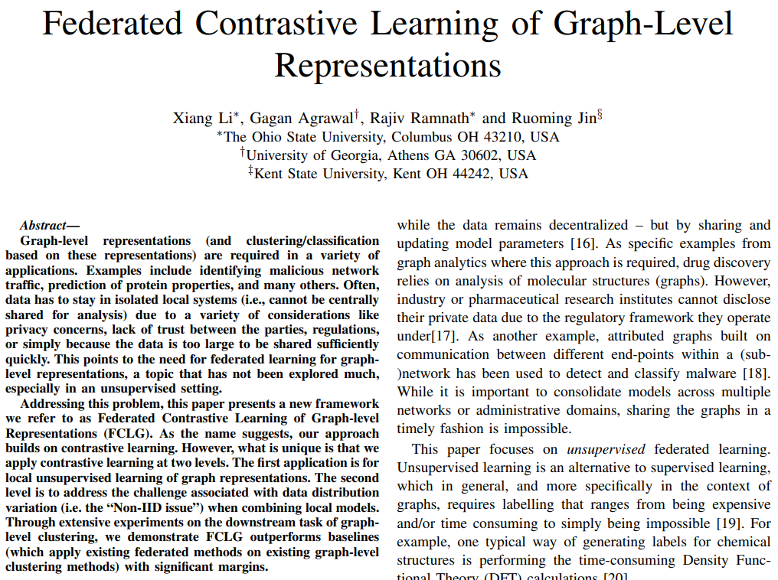
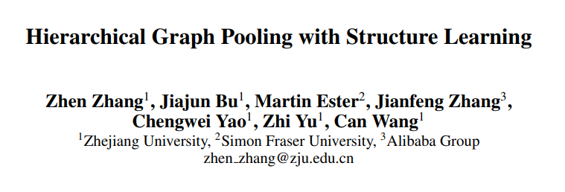
Dataset – Related Works
Graph Convolutional Network (GCN)
Dataset
AIDS
DHFR (Class -1, 1)
PTC_MR (Class -1, 1)
Mutagenicity
Graph Partitioning Neural Networks (GPNNs)
GINε (Xu et al., 2019) and GIN-ε-JK with jumping knowledge networks as neural baselines (Xu et al., 2018)
Notes:
KC
Todo: reference this in the report -> e.g. baseline reference
-> we are using pretty standard GNN and want to see how close we come to the state-of-the-art
Todo: include related work on ML model
-> I would not have the screenshots like this but actual numbers e.g. what is their accuracy on the datasets such that we can compare later on

Slide 42
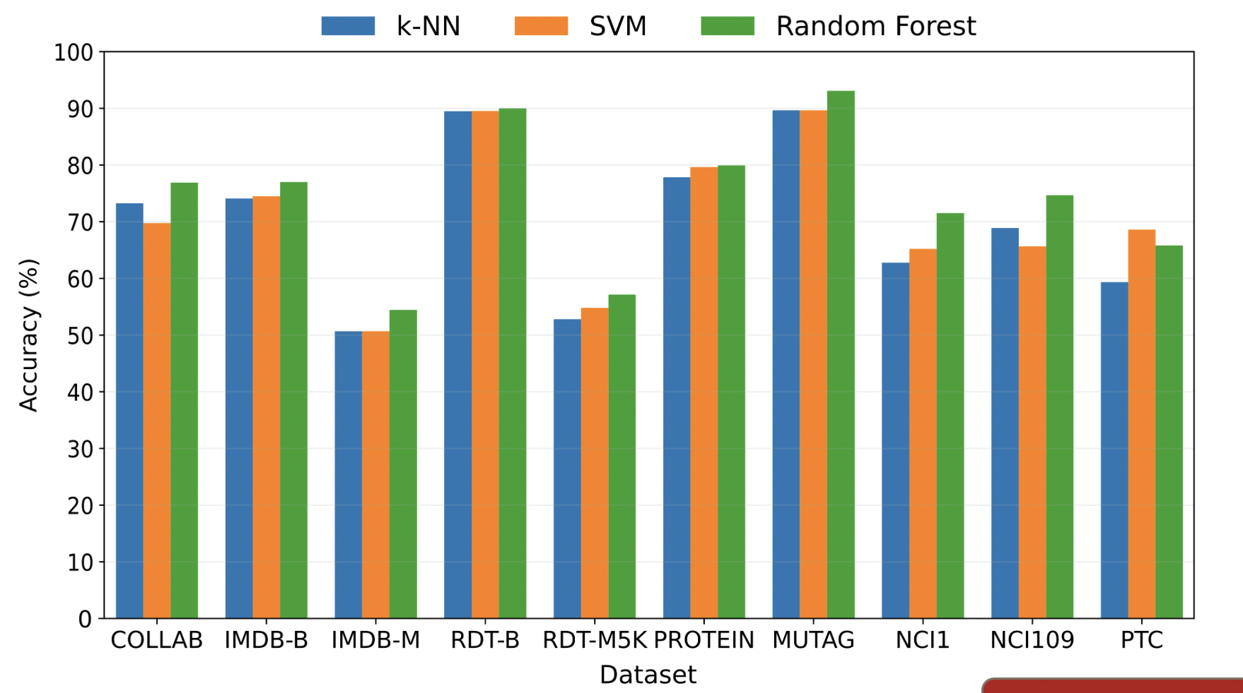
Previous Research on ML models
Using graph properties (other datasets)
Using Molecular fingerprint similarity analysis (other datasets)
1. Wen-Xing Li, Xin Tong, Peng-Peng Yang, Yang Zheng, Ji-Hao Liang, Gong-Hua Li, Dahai Liu, Dao-Gang Guan, & Shao-Xing Dai.
“Screening of antibacterial compounds with novel structure from the FDA approved drugs using machine learning methods.”
Available at: ResearchGate
2. Saiful Islam, Md. Nahid Hasan, Pitambar Khanra.
“A Structural Feature-Based Approach for Comprehensive Graph Classification.”
Preprint available at: arXiv:2408.05474v1
Notes:
Lack of Systematic Comparative Evaluations across Datasets
Although both paradigms (fingerprint-based vs. GNN) are popular, there is a noted lack of systematic, head-to-head evaluations of these methods on diverse biochemical datasets. Yang et al. (2019) pointed out that despite many individual successes, “recent literature has yet to clearly determine which of these two methods is superior when generalizing to new chemical space.” . They also note that “prior research has rarely examined these new [graph] models in…comparison to existing employed models” in industry settings . This indicates that comprehensive benchmarks pitting traditional descriptors against modern GNNs were largely missing until recently. Most studies tend to evaluate a new method in isolation or on a narrow set of tasks, leaving a gap in understanding how these approaches compare across many datasets or endpoints.
Notably, the MoleculeNet paper (Wu et al., 2018) introduced a large suite of molecular benchmarks, and many GNN papers report results on those. However, systematic inclusion of classical descriptors in those benchmarks was limited, leading to an incomplete picture. The 2021 study by Jiang et al. was one of the first extensive comparisons (11 public datasets) bridging that gap . The authors explicitly state that earlier claims of GNN superiority were “controversial” and not uniformly verified, motivating their work . Their findings (that no one method is universally best) underscore the importance of such broad evaluations.
When it comes to public graph datasets like TUDataset, the issue is similar. TUDataset (Morris et al., 2020) collects dozens of graph classification tasks (including chemical molecule datasets like MUTAG, NCI1, enzymes, etc.) and provides baseline results for graph kernels and GNN algorithms . While this benchmark is invaluable, the focus has been on comparing graph-based techniques (e.g. Weisfeiler-Lehman graph kernel vs. GIN neural network) . Traditional chemical fingerprints or physico-chemical descriptors are generally not included as baseline features in these graph learning benchmarks. This means there is no systematic public record of how a simple fingerprint+XGBoost model would fare against state-of-the-art GNNs on all these diverse graph datasets – an analysis that remains underexplored in literature. A recent survey confirms that many GNN papers rely on the same benchmark splits and metrics, but “discrepancies in … data split across the literature can entail unfair performance” comparisons , suggesting that even when comparisons exist, they may not be on equal footing. Overall, there is a consensus in recent reviews that more thorough and fair comparisons are needed. The lack of broad evaluation spanning multiple data types (toxicity, bioactivity, protein networks, etc.) and dataset sources has been a blind spot. Addressing this would help determine where each paradigm excels and guide practitioners on choosing the appropriate method for new datasets.
Moreover, the cheminformatics literature tends to focus on thousands of chemical descriptors specifically designed for molecules (e.g., counts of particular functional groups, electronegative atom fractions, etc.), and those often overshadow simple graph metrics.

Slide 43
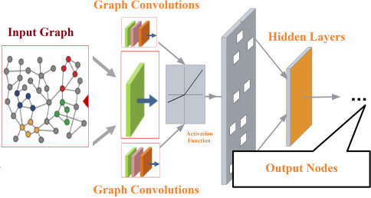
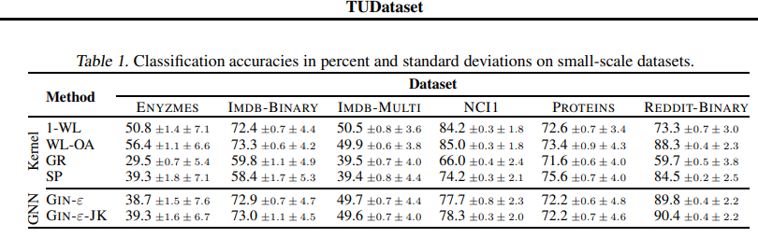
Previous Research on GNN
GNN benchmarks for some TUDatasets
1. TUDataset: A collection of benchmark datasets for learning with graphs
Notes:
Kevin

Slide 44
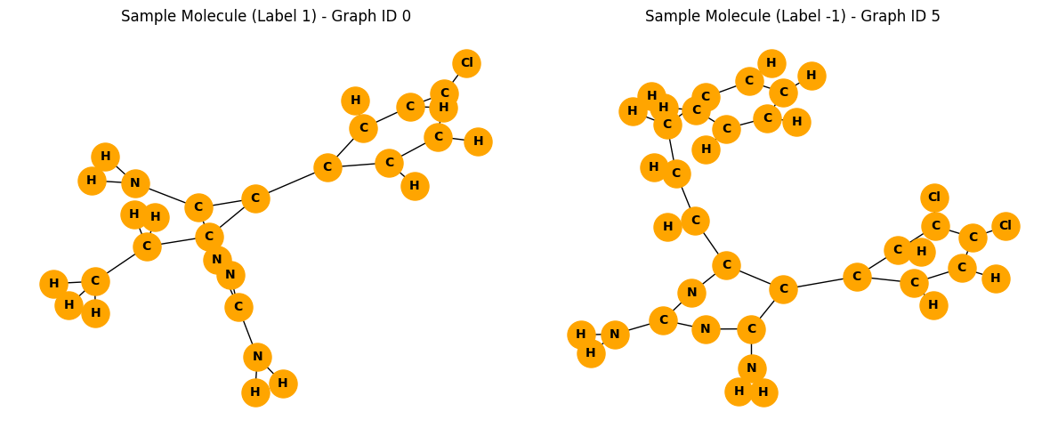
Graph visualization DHFR
RDKit Representation

Slide 45

Statistical Relevance
T-tests results:
 | t-value | p-value
Density | 5.242 | $${2.08e}^{−7}$$
SPID | -4.218 | $${2.8e}^{−5}$$
Clustering | nan | nan
Num nodes | -4.721 | $${2.84e}^{−6}$$
Notes:
Very significant difference. Graphs with label active have higher density on average than graphs with inactive.
statistical testing only tells us whether the difference in means is unlikely to have occurred by chance, given the sample size and variance.
Overlap in SPID (5th–95th percentile): [4.856, 7.736] Overlap accounts for approx. 73.5% of the total combined range.
The sample size is relatively large (~300 graphs per group)
The within-group variance is relatively low
The t-test is very sensitive to consistent, even small, mean differences when variance is tight
Statistical significance does not always imply practical predictive power.
The p-values are tiny, meaning that the difference in averages is not due to chance. Thus on average, the groups are different — but averages don’t tell the full story. Statistical significance tells you about group differences. Classification needs individual-level separation.
Coefficient = 0 for every graph: every graph under consideration has no triangles — i.e., no closed triplets

Slide 46
Classifiers
ML Models
GNN
Linear Regression
XGBoost
SVM
K Nearest Neighbours
Random Forest
…
https://ars.els-cdn.com/content/image/1-s2.0-S2472555223000710-gr1.jpg

Slide 47


Graph Convolutional neural networks (GCN)
Idea comes from CNNs (images)
Adopted to Graphs

Slide 48



Graph Convolutions vs Pooling

Slide 49

Fingerprints: Molecules as Barcodes
Do it quick
Iteration 0: atom invariant (basic description)
Iteration 1: new key with info on immediate neighbors
Iteration 2: new keys for each atom’s 2-bond environment
1
1
1
3278547580449
478789234849395
29863091736485
https://chemicbook.com/2021/03/25/a-beginners-guide-for-understanding-extended-connectivity-fingerprints.html
Notes:
Carlotta : : turning molecules into barcodes for computers
ECFP4 stands for Extended-Connectivity Fingerprint with a radius of 2 (which means looking up to 2 bonds away, or a diameter of 4). It is a way to describe a molecule using numbers so that a machine learning model can understand it.
First look only at one atom, collect basic information (what kind of atom, how many bonds, part of a ring, what’s it’s charge?) -> construct initial ID
Then At radius 2, we look at the atom, its neighbors, and their neighbors.
Each neighbourhood is encoded into a number (key)
Process every atom in a molecule -> get many keys
You take each of these keys and map them to a fixed-size vector, let’s say with 2048 bits.
Each key “turns on” a bit in this vector. So if your hash value is 290, you turn on bit number 290.
In the end, you get a binary vector like this:0000000000100000010000...
Each 1 means a certain chemical feature is present in the molecule.
Left: graph/network representation:
Each node = atom.
Each edge = bond between atoms.
No chemical meaning yet — pure graph structure.
Middle: chemical molecule visualized using RDKit.
Same atoms and bonds as the left graph — but now showing:
atom types (e.g., C, N, O)
bond multiplicities (single, double, etc.)
3D coordinates optimized for chemistry.
Chemical properties are now respected.
Right panel: fingerprint image of the same molecule.
It’s a 2D bit matrix visualization of the ECFP4 fingerprint.
What you actually see:
Each white pixel = a specific local substructure (atom+neighbor environment) detected.
Black background = no substructure matched for that bit.
Positions (which bit is activated) are fixed and arbitrary:
e.g., bit 245 could mean “a carbon atom bonded to an amine group” — it’s based on hashing.
It looks sparse (lots of black) because:
Molecules only match a small fraction of all possible substructures.
Typical fingerprints (like ECFP4) are very high-dimensional (2048 bits).
Let’s zoom in on one of the most common fingerprints: ECFP4, short for Extended-Connectivity Fingerprint with radius 2.
Here’s how it works: starting from each atom in a molecule, we build substructures by looking at neighboring atoms up to a certain ‘diameter’—in this case, 4 bonds across. These substructures are then encoded into numerical IDs called ‘keys.’
Finally, these keys are passed through a hashing function to get bit positions in a fixed-length binary vector. The result? A unique and compact fingerprint that captures the local chemical environment of each atom—perfect for machine learning.

Slide 50
Fingerprints as Features
Binary vectorized representations of molecules
Chemical substructure captured in a 2048-bit vector
Sparse feature matrix (2.8% density)
Notes:
Carlotta : : turning molecules into barcodes for computers
ECFP4 stands for Extended-Connectivity Fingerprint with a radius of 2 (which means looking up to 2 bonds away, or a diameter of 4). It is a way to describe a molecule using numbers so that a machine learning model can understand it.
First look only at one atom, collect basic information (what kind of atom, how many bonds, part of a ring, what’s it’s charge?) -> construct initial ID
Then At radius 2, we look at the atom, its neighbors, and their neighbors.
Each neighbourhood is encoded into a number (key)
Process every atom in a molecule -> get many keys
You take each of these keys and map them to a fixed-size vector, let’s say with 2048 bits.
Each key “turns on” a bit in this vector. So if your hash value is 290, you turn on bit number 290.
In the end, you get a binary vector like this:0000000000100000010000...
Each 1 means a certain chemical feature is present in the molecule.
Left: graph/network representation:
Each node = atom.
Each edge = bond between atoms.
No chemical meaning yet — pure graph structure.
Middle: chemical molecule visualized using RDKit.
Same atoms and bonds as the left graph — but now showing:
atom types (e.g., C, N, O)
bond multiplicities (single, double, etc.)
3D coordinates optimized for chemistry.
Chemical properties are now respected.
Right panel: fingerprint image of the same molecule.
It’s a 2D bit matrix visualization of the ECFP4 fingerprint.
What you actually see:
Each white pixel = a specific local substructure (atom+neighbor environment) detected.
Black background = no substructure matched for that bit.
Positions (which bit is activated) are fixed and arbitrary:
e.g., bit 245 could mean “a carbon atom bonded to an amine group” — it’s based on hashing.
It looks sparse (lots of black) because:
Molecules only match a small fraction of all possible substructures.
Typical fingerprints (like ECFP4) are very high-dimensional (2048 bits).
Let’s zoom in on one of the most common fingerprints: ECFP4, short for Extended-Connectivity Fingerprint with radius 2.
Here’s how it works: starting from each atom in a molecule, we build substructures by looking at neighboring atoms up to a certain ‘diameter’—in this case, 4 bonds across. These substructures are then encoded into numerical IDs called ‘keys.’
Finally, these keys are passed through a hashing function to get bit positions in a fixed-length binary vector. The result? A unique and compact fingerprint that captures the local chemical environment of each atom—perfect for machine learning.

Slide 51
Feature Engineering: Graph Theoretical Metrices
Density
avg. clustering
SPID
num Edges/ Nodes
std./mean/min/max Degree
Diameter
Radius

